Slide 1
Intel 8086 Microprocessor Architecture

Slide 2
The 8086 Processor Model
The block diagram of intel 8086 contains two independent functional units:
Bus Interface unit (BIU)
Execution Unit (EU)

Slide 3
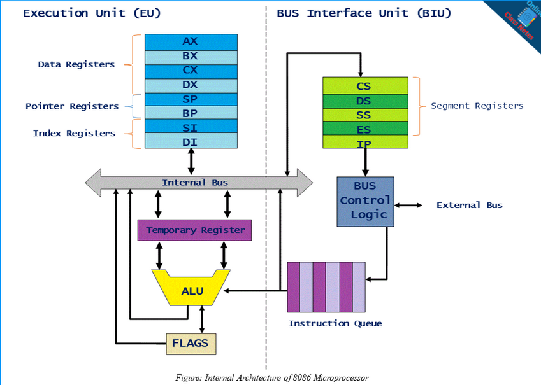

Slide 4
1.Bus Interface Unit (BIU)
The bus interface unit contains:
6-Byte instruction queue: stores pre-fetched bytes First-In-First-Out 6 byte register .
Segment register: CS, DS,ES,SS.
Instruction pointer: It points to the address of the next instruction to be executed.
Functions of Bus Interface Unit:
It perfoms instruction fetching, reading and writing for memory and I/O and calculating the address of the memory operands.

Slide 5
It stores fetched instruction codes in a First In First Out(FIFO) register called queue.
Fetching the next instruction while the current instruction executes is called pipelining.

Slide 6
2.Execution Unit(EU)
The EU receives program instruction codes and data from BIU, executes these instructions and stores the result in the general registers.
Main components are:
Instruction decoder: translates instructions fetched from memory.
Control system: responsible for the co-ordination of all other units of the processor.
Arithmetic logic unit.
General purpose registers: used for temporary storage .

Slide 7
V. Flag register: contains 9 active flags; 6 conditional flags and 3 control flags.
VI. Pointer & index register: SP, BP,SI,DI.
Functions of Execution Unit:
Decodes instructions fetched by BIU.
Generate control signals.
Executes instructions.

Slide 8
General purpose register
There are 8 general purpose registers, AH, AL, BH, BL, CH, CL, DH, and DL. These registers can be used individually to store 8-bit data and can be used in pairs to store 16 bit data. The valid register pairs are AH and AL, BH and BL, CH and CL, and DH and DL. It is referred to the AX, BX,CX, and DX respectively.
AX register − It is also known as accumulator register. It is used to store operands for arithmetic operations.
BX register − It is used as a base register. It is used to store the starting base address of the memory area within the data segment.
CX register − It is referred to as counter. It is used in loop instruction to store the loop counter.
DX register − This register is used to hold I/O port address for I/O instruction.

Slide 9
The Flags Register
It is a 16-bit register, also called Program Status Word (PSW). Seven bits remain unused while the rest nine are used. Six are status flags and three are control flags.
The control flags
1. DF (Direction Flag) : controls the direction of operation of string instructions. (DF=0 Ascending order DF=1 Descending order)
2. IF (Interrupt Flag): controls the interrupt operation in 8086μP.
(IF=0 Disable interrupt IF=1 Enable interrupt)
3. TF (Trap Flag): controls the operation of the microprocessor.
(TF=0 Normal operation TF=1 Single Step operation)

Slide 10
The status flags are set/reset depending on the results of some arithmetic or logical operations during program execution.
1. CF (Carry Flag) is set (CF=1) if there is a carry out of the MSB
position resulting from an addition operation or subtraction.
2. AF (Auxiliary Carry Flag) AF is set to 1 When some arithmetic operations generates carry after the lower half and sends it to upper half.
3. SF (Sign Flag): set to 1 when result is negative. When result is positive it is set to 0.
4. ZF (Zero Flag): is set to 1 when result of an arithmetic or logical operation is zero. For non-zero result this flag is reset (ZF=0).
5. PF (Parity Flag): this flag is set to 1 when there is even number of 1 bits in result, and to 0 when there is odd number of 1 bits.
6. OF (Overflow Flag): set to 1 when there is a signed overflow

Slide 11
Index/Pointer registers:
The other four registers of EU are referred to as index / pointer registers.
. The pointer registers contain the offset within a particular segment.
The BP & SP registers are 16-bits registers which hold the offsets within the data and stack segments respectively.
The Index registers are used as general purpose registers as well as for holding the offset in case of indexed based and relative indexed addressing modes.
The source Index register is generally used to store the offset of source data in data segment while the Destination Index register used to store the offset of destination in data or extra segment.
These index registers are specifically used in string manipulations
ALU(Arithmetic and Logical Unit)
It handles all arithmetic and logical operations, like +, −, ×, /, OR, AND, NOT operations.

Slide 12
Fetch and execute cycle
This is what happens when the 8086 or 8088 is first started.
The BIU outputs the contents of the instruction pointer register (IP) onto the address bus, causing the selected byte or word to be read into the BIU.
Register IP is incremented by 1 to prepare for the next instruction fetch.
Once inside the BIU, the instruction is passed to the queue. This is a first-in, first-out storage register sometimes likened to a "pipeline".
Assuming that the queue is initially empty, the EU immediately draws this instruction from the queue and begins execution.

Slide 13
While the EU is executing this instruction, the BIU proceeds to fetch a new instruction.
Depending on the execution time of the first instruction, the BIU may fill the queue with several new instructions before the EU is ready to draw its next instruction.

Slide 14
باشراف د. عمر أحمد إعداد: خولة محمد (علوم الحاسوب) نسمية أبو (علوم الحاسوب) سبيدة يحي(تقانة المعلومات)

